Slide 1
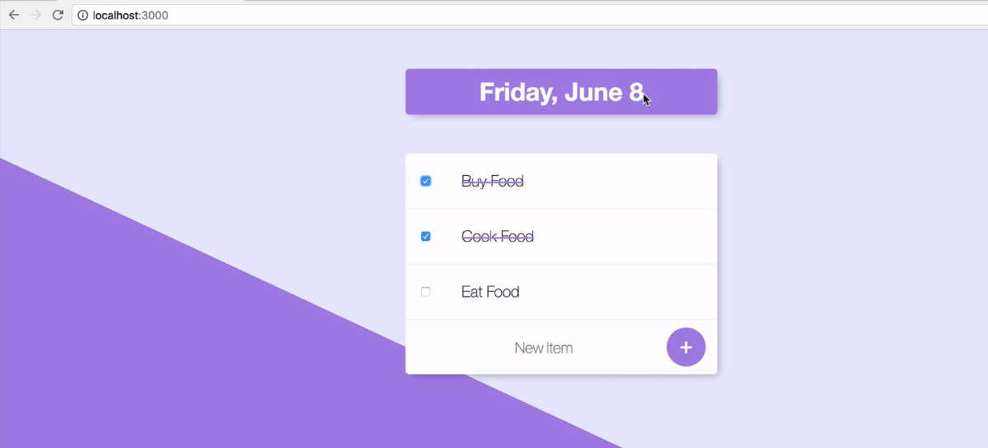
When we develop with web application , it is usual thing to use same template to display header or some other component which is required to appear same. This time Template is very useful.

Slide 2
In our todolist v1 application, we will get different title when we open each day.
Let we modify our existing todolist v1 application, and start using template to design our page titles.

Slide 3
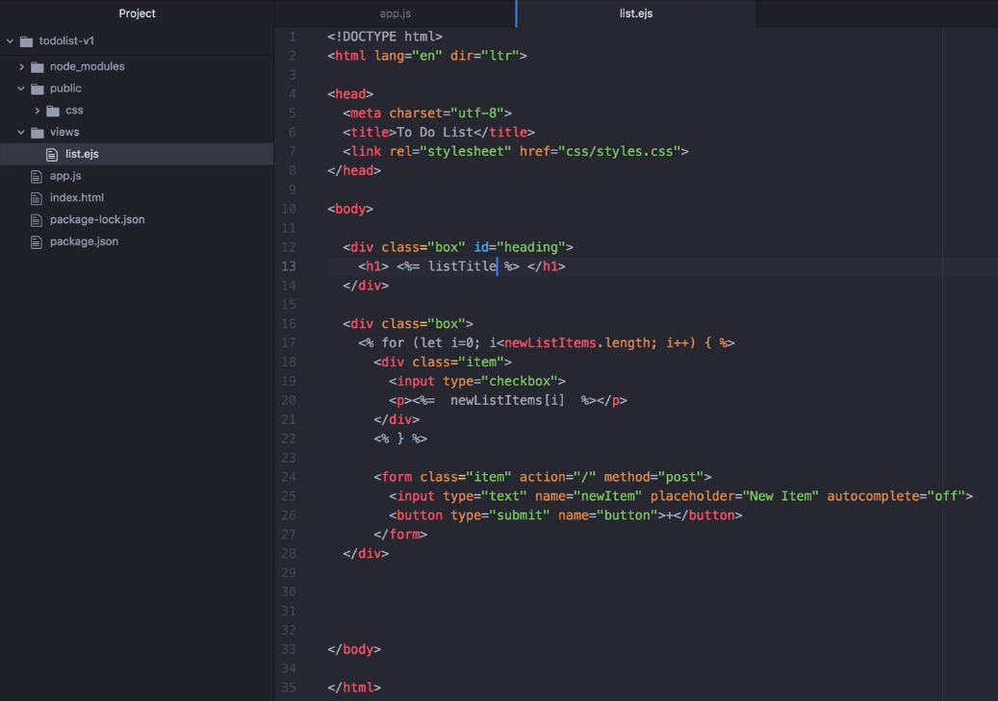
Change kindofDay
into listTitle
at list.ejs

Slide 4
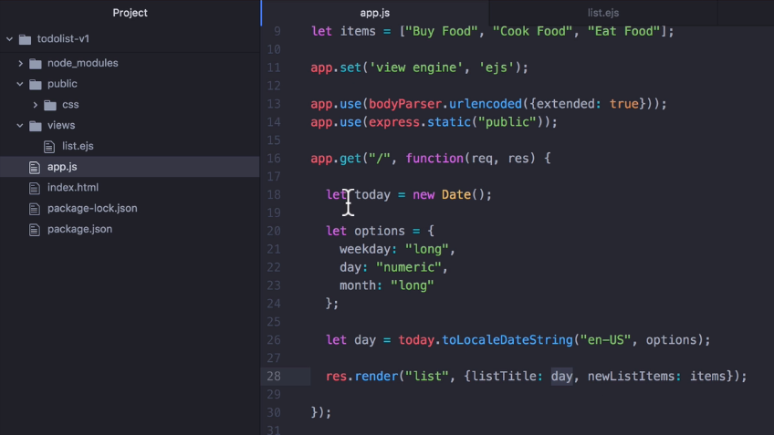
Change kindofDay
into listTitle
at app.js

Slide 5
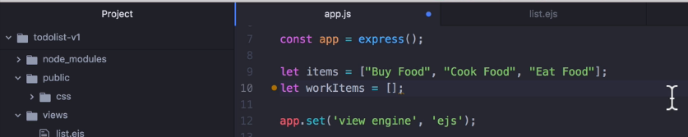
Declare one array to store work items

Slide 6
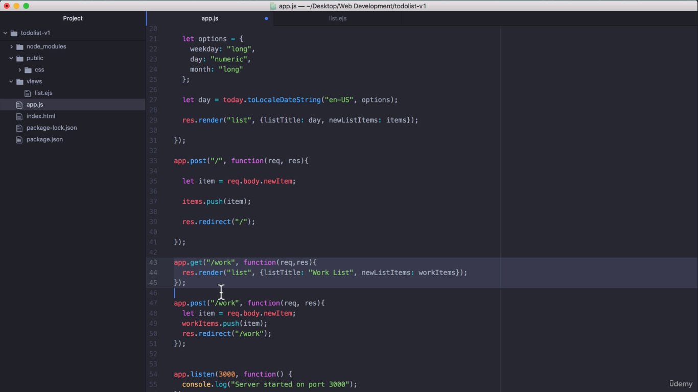
Use an array inside work get route

Slide 7
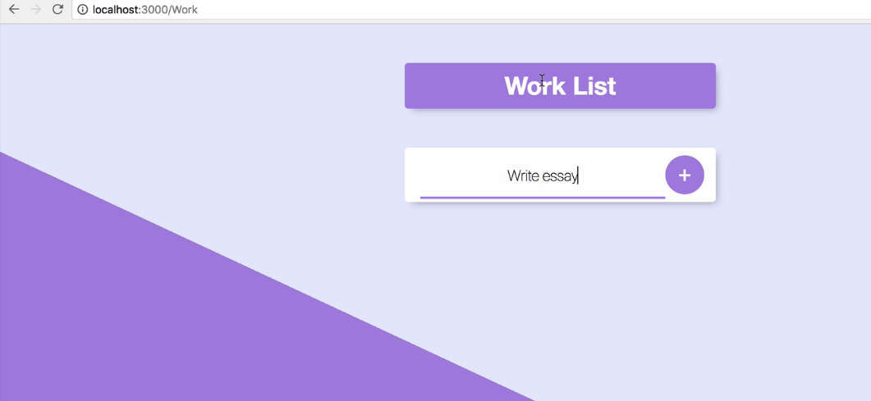
In the following output, if we add any new item, it is displaying at
default route or home route page.

Slide 8
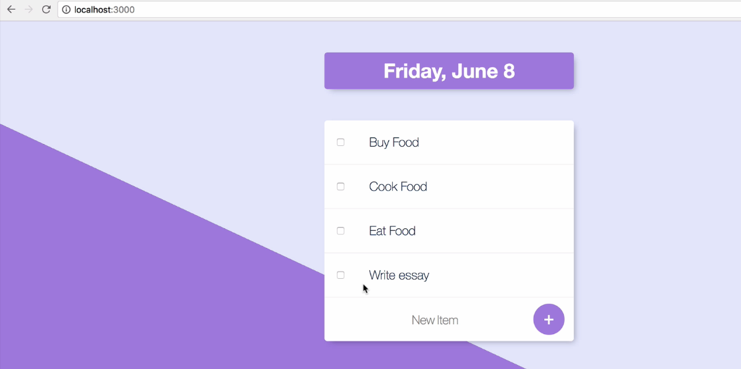
Output : Write essay is added at “get work route” – But it is added in the home route list

Slide 9
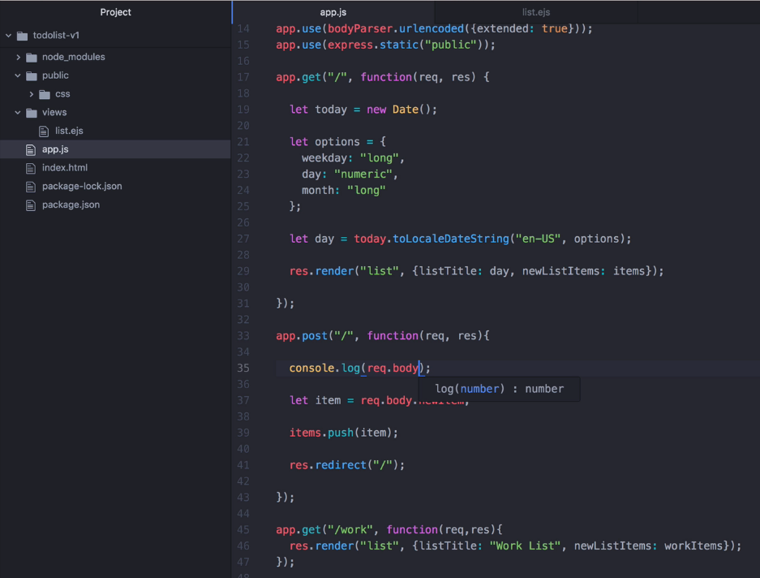
Checking our code using
Console.log() at post home route.

Slide 10
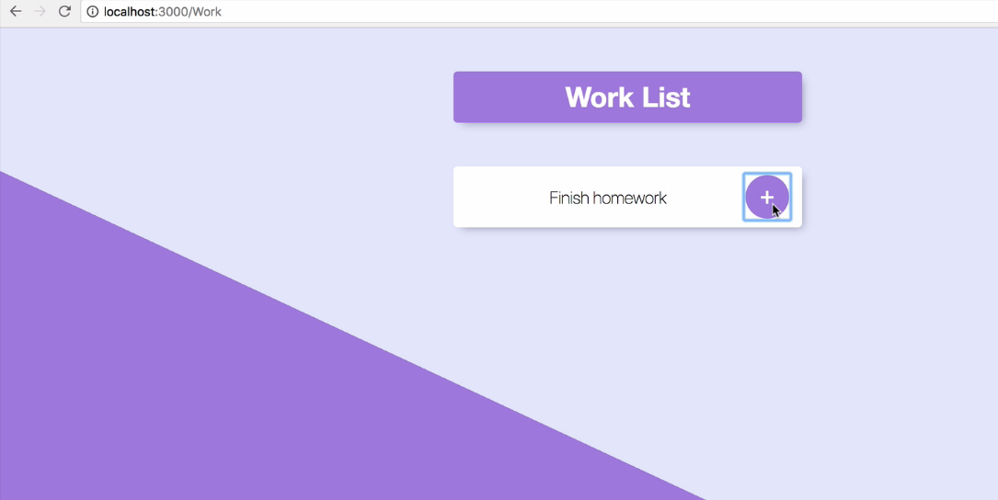
Adding New Item: Checking our code using Console.log() at post home route.

Slide 11
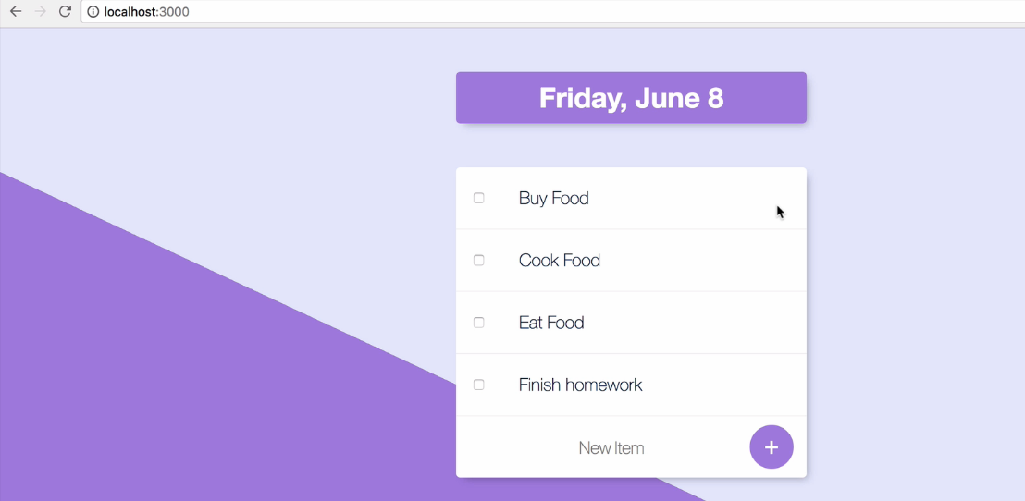

Slide 12
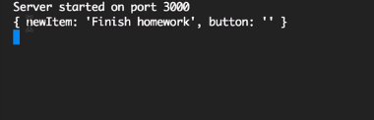
When we log our Work, inside home post route, Then we can see
The values of each object.

Slide 13
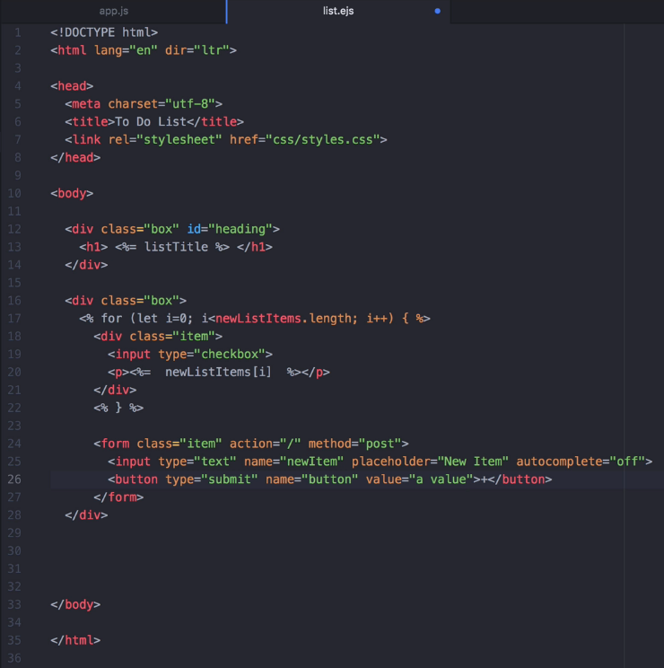
Add a value field at button element.

Slide 14
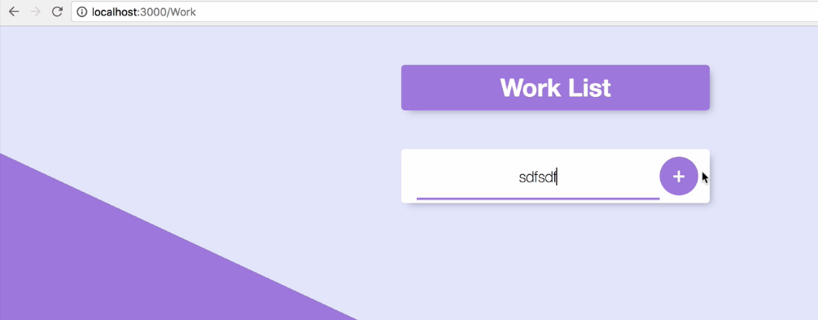
Add one more item name at work route get, then it will be listed at
Home route get.

Slide 15
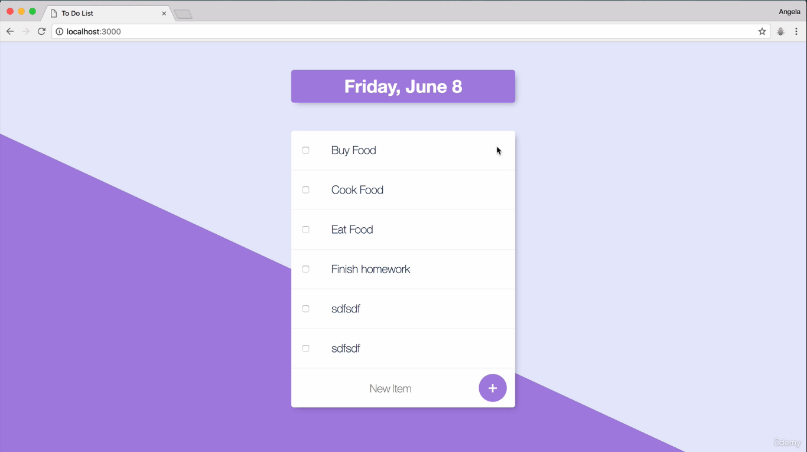

Slide 16
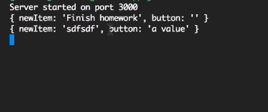

Slide 17
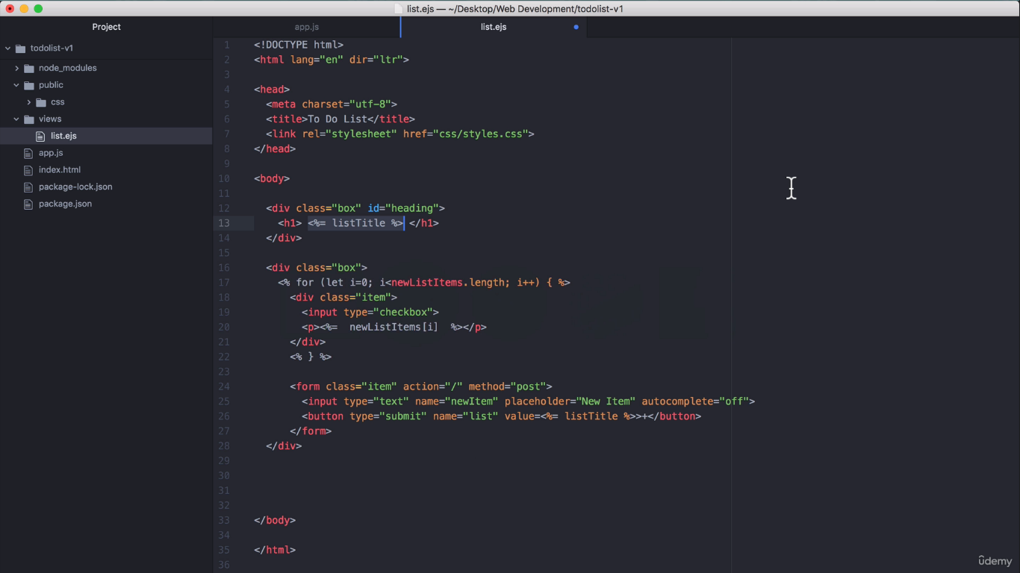
Add a value field at button element, to display dynamically.

Slide 18
Add one more item name at work route get, then it will be listed at
Home route get.

Slide 20
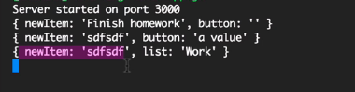

Slide 21
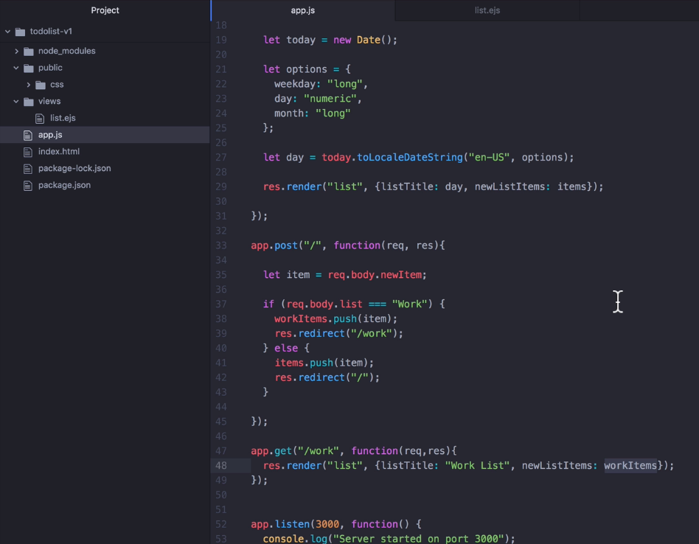
Do change our
post method – like adding logic.
If we add item in work route then items to be added at work itself. And the same logic at home route.

Slide 22
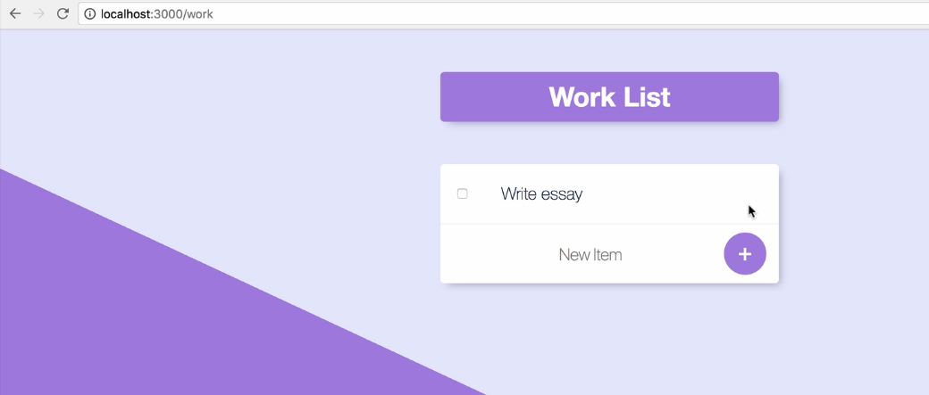

Slide 23
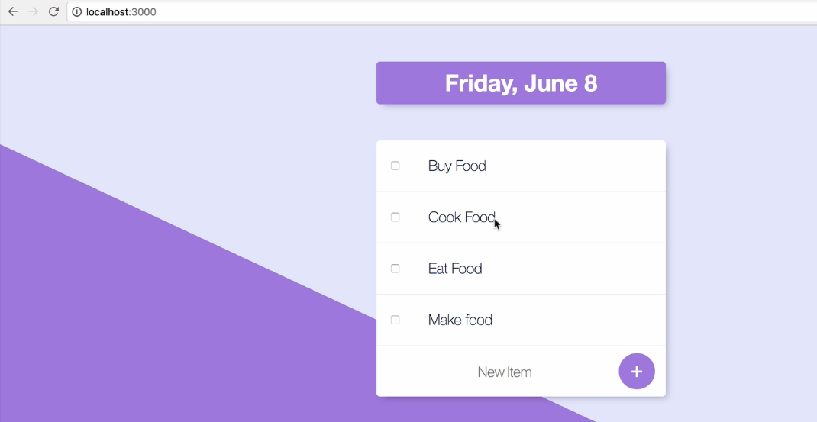

Slide 24
In case, if we want to create separate web pages like about.html or contact.html then ?
Here design and contents are totally different.
EJS provides layout concept to solve this kind of problems.

Slide 25
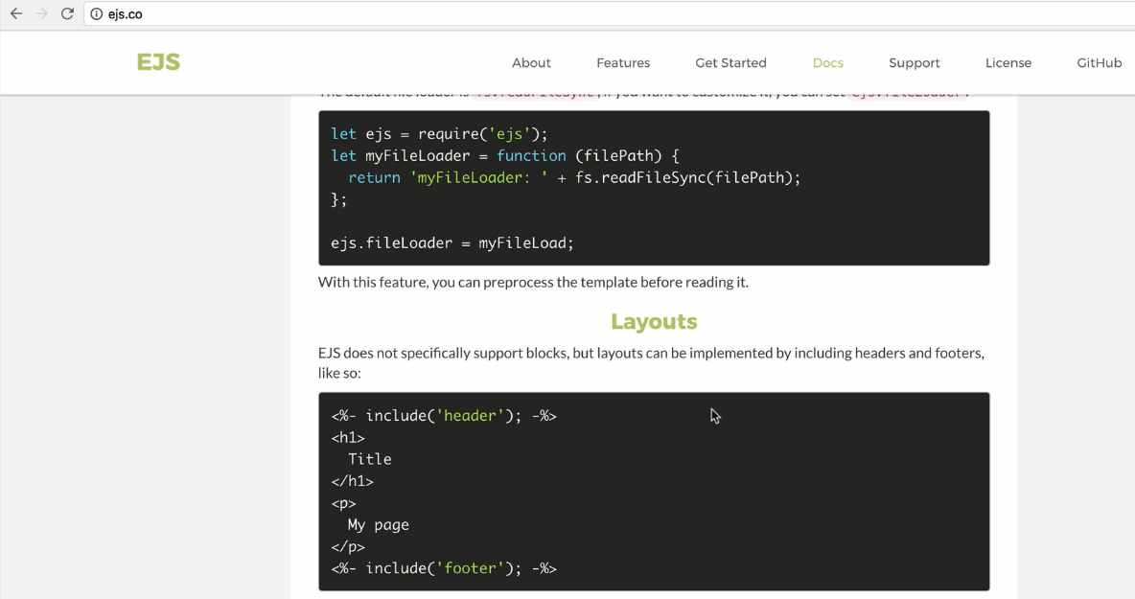

Slide 26
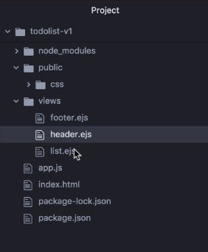
Create header.html
Footer.html files

Slide 27
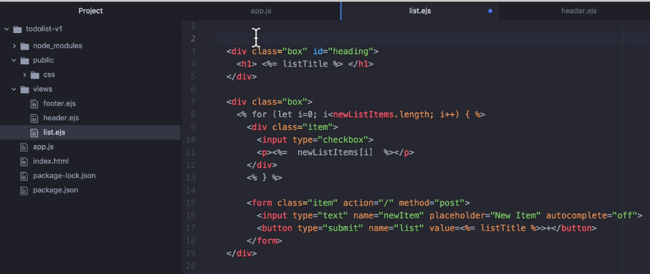
Remove header & footer parts at list.ejs file

Slide 28
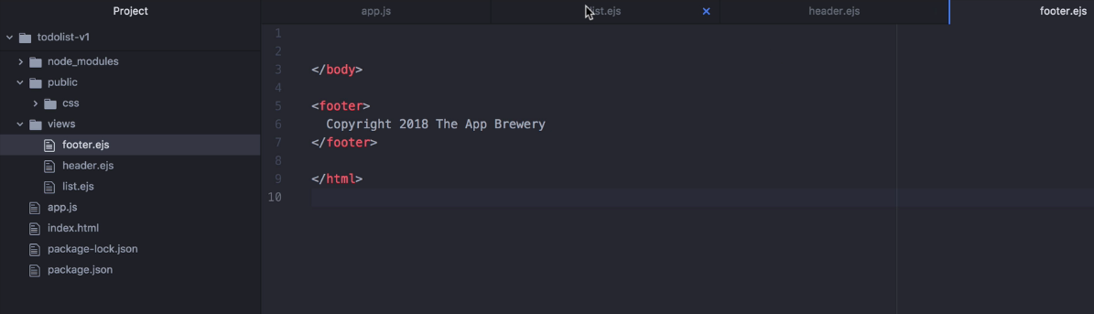
Adding content to footer.html

Slide 29
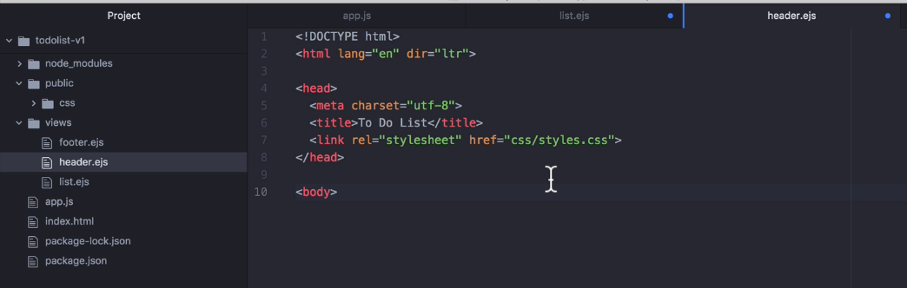
Adding content to header.html

Slide 30
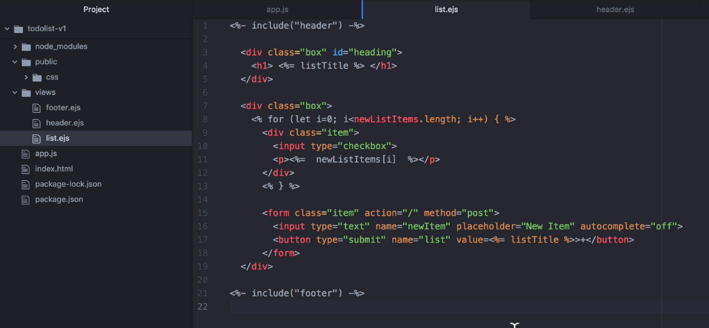
Adding header & footer using special ejs tag <%- -%> at list.ejs

Slide 31
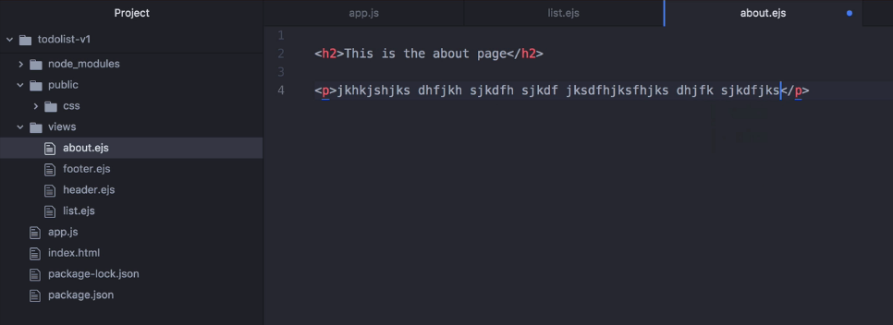
Create about.html

Slide 32
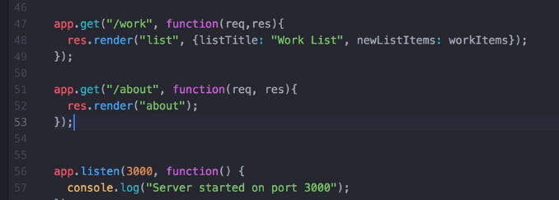

Slide 33
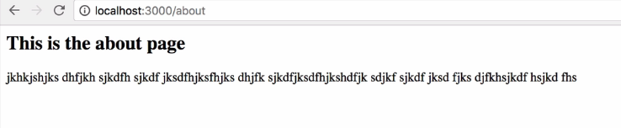

Slide 34
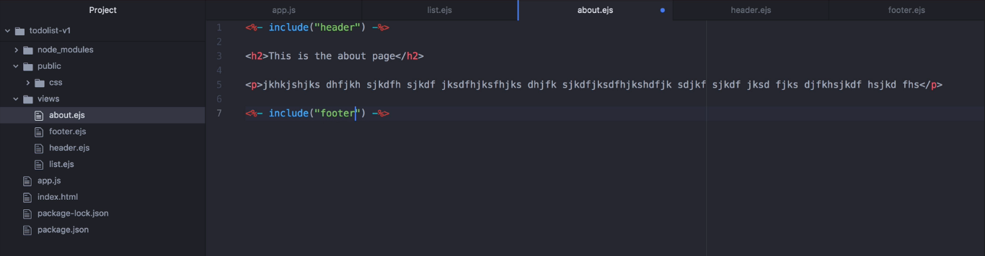

Slide 35
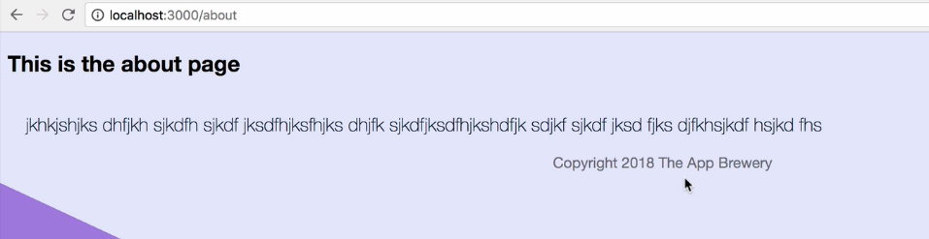

Slide 36
We can use layout concept to include any file (styles/js/html) into our existing web page

